Slide 1
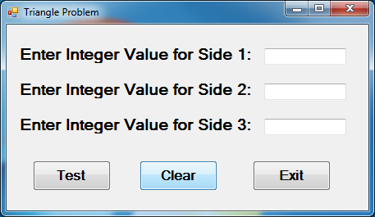
Requirements for the Triangle Problem
Input: Three integers, a, b, c, the lengths for each side of a triangle (value range 1-200)
Output: Scalene, isosceles, equilateral, or invalid triangle
1
1

Slide 2
Reminder: Triangle Properties
No side may have a length of zero or less
Sum of two sides must be greater than the other side of the triangle
Equilateral triangle: all three sides are equal
Isosceles triangle: any two sides are equal
Scalene triangle: all sides are unequal

